Slide 1
CAI1001C
AI Thinking
Demystifying AI and the Evolution of AI

Slide 2
Disclaimer
Miami Dade College has adapted the content on the subsequent slides from the AI for Current Workforce program, which is part of Intel® Digital Readiness Programs.

Slide 3
Learning Objectives
By the end of this lesson, you will be able to:
1. Define Artificial Intelligence and explain its key characteristics
2. Identify the key historical figures and milestones in AI development (1943-1956)
3. Distinguish between AI and Automation
4. Recognize cognitive abilities as a key differentiator of AI systems
5. Describe real-world applications of AI technology

Slide 4

Course Description
Empower future workforce with necessary AI skills for employability in the digital economy.
Gain AI technical confidence.
Enhance skill-set for AI-related jobs.

Slide 5
What is Artificial Intelligence?

Slide 6
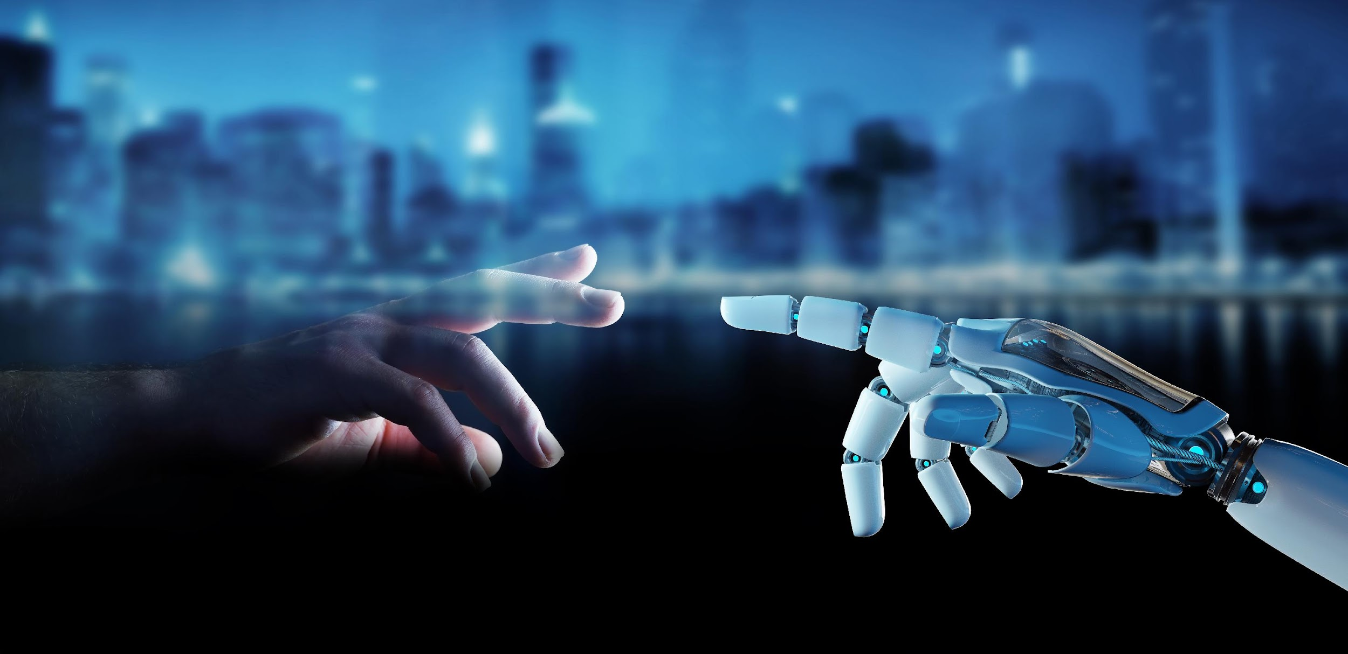
What is Artificial Intelligence?
“the Science and Engineering of making intelligent machines ”
—John McCarthy

Slide 7
Why Artificial Intelligence?
AI adds intelligence to existing products.
Example: Adobe Photoshop’s Select Subject feature, uses a sophisticated AI to select part of an image that resembles the focus of a shot.
Automates repetitive learning.
Example: AI systems to predict and prevent traffic jams
Adapts through learning from user experience.
Example: Chatbots to answer customer’s queries

Slide 8

History and Evolution of AI
AI term coined in 1956 by John McCarthy at Dartmouth College
Turing Test, important concept in the philosophy of AI
Described by Alan Turing in 1950.
Determines whether computers are capable of Human Intelligence.
Uses computers to simulate intelligent behavior and critical thinking.
Notes:
AI has a rich history that dates back to the mid-20th century. Its evolution has been marked by significant developments, from early theories and experiments to the sophisticated algorithms we see today. Let's take a historical journey to understand these milestones.

Slide 9
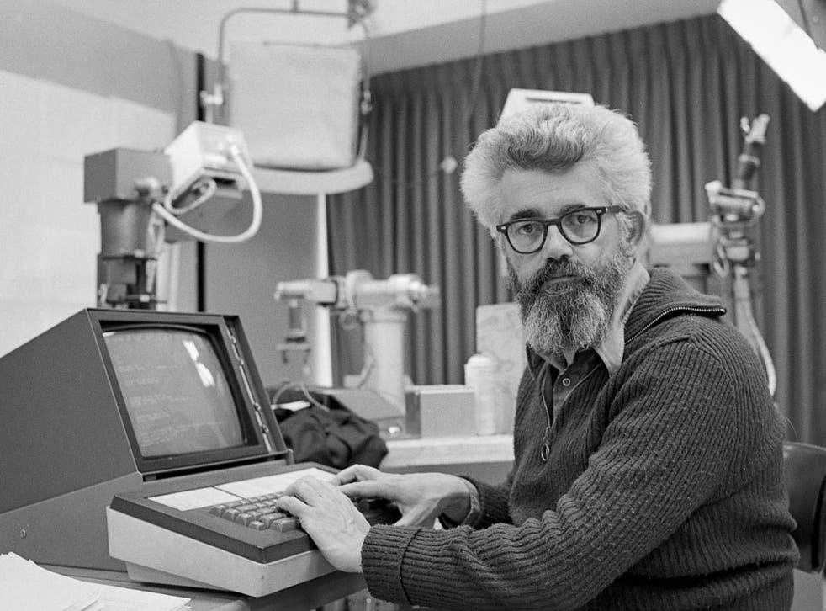
John McCarthy: the Father of AI
Invented the first programming language for symbolic computation LISP
Coined the term “AI”
Key contributions area
Human-level AI
Commonsense reasoning
Awards
ACM Turing Award, 1971
Kyoto Prize, 1988
National Medal of Science, 1990
Benjamin Franklin Medal, 2003
"I don't see that human intelligence is something that humans can never understand.“
~ John McCarthy, March 1989
Notes:
One of the pivotal figures in AI's history is John McCarthy. Often referred to as the 'Father of AI', McCarthy was instrumental in defining the field and organizing the famous Dartmouth Conference in 1956, where the term 'Artificial Intelligence' was coined.

Slide 10
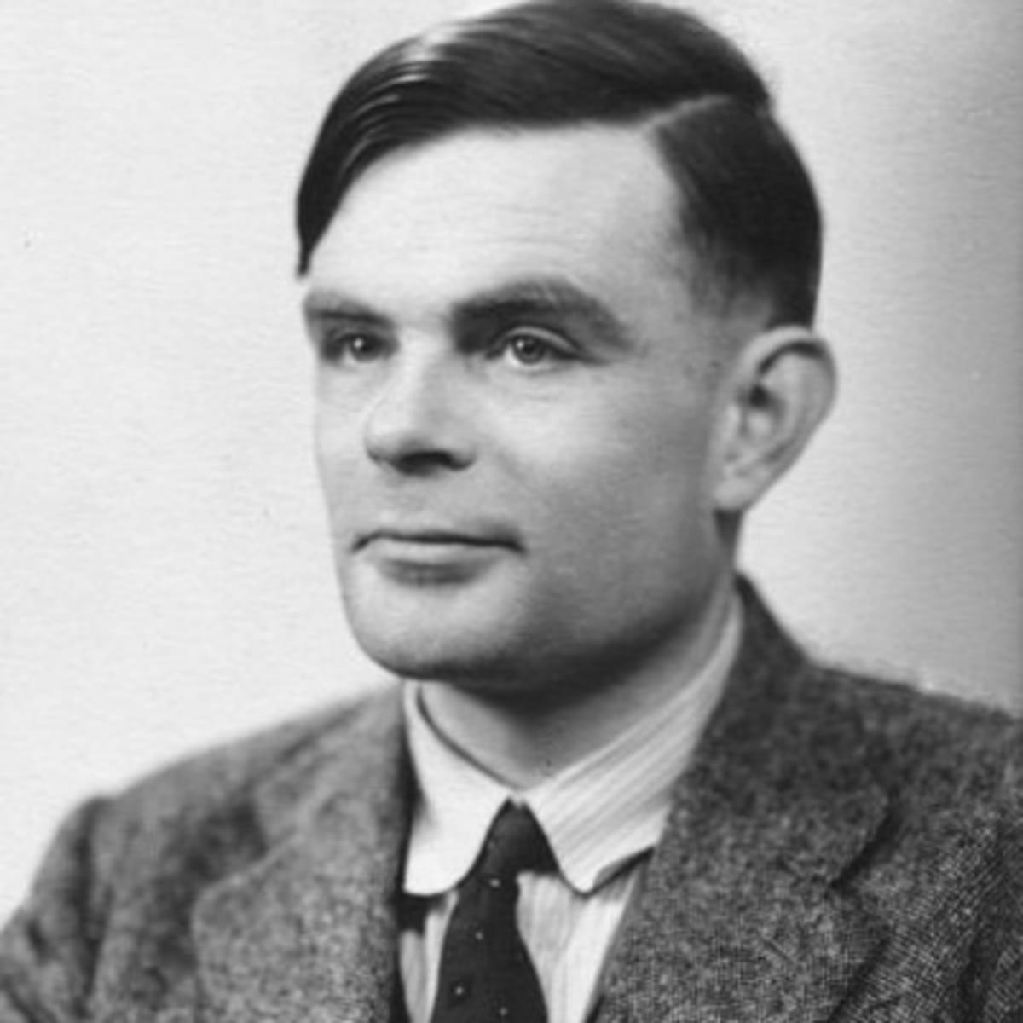
Alan Turing
British mathematician who took a leading role in breaking Nazi ciphers during WWII.
Key contributions area
Theoretical computer science
Algorithm
Awards
Order of the British Empire, 1946
Fellow of the Royal Society (FRS), 1951
Benjamin Franklin Medal, 2003
"100 Most Important People of the 20th century” Time magazine 1999
Notes:
Another key figure is Alan Turing, a brilliant mathematician and computer scientist. Turing is best known for the Turing Test, a criterion of intelligence in a machine. His work laid the groundwork for what we consider AI today.

Slide 11
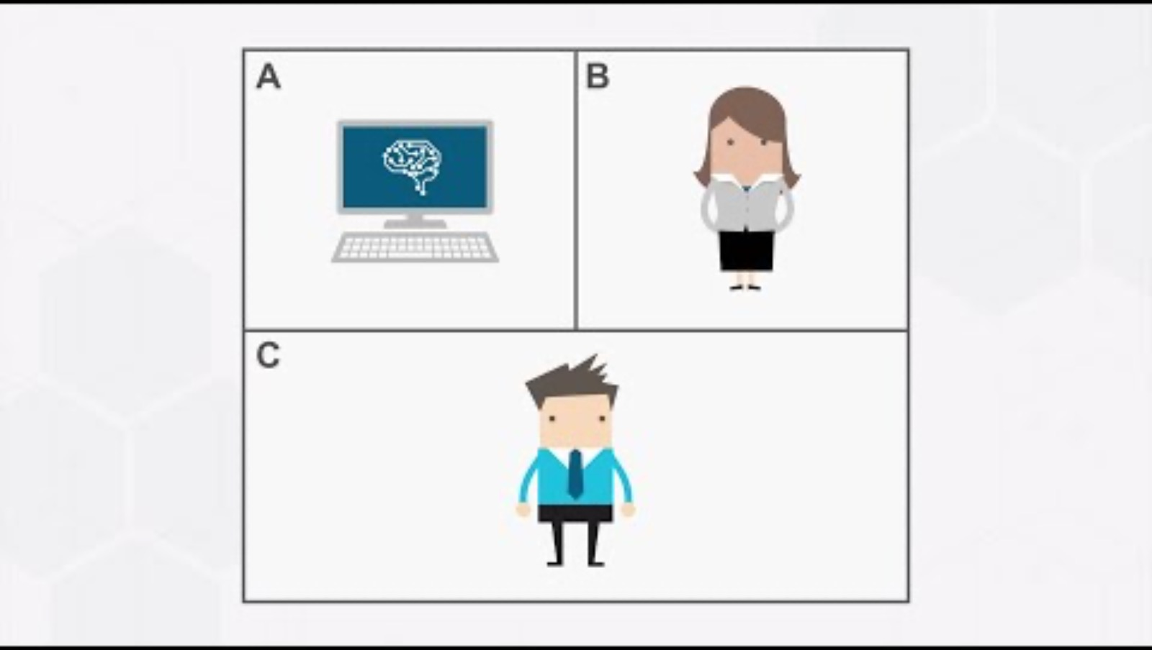
Notes:
https://www.youtube.com/watch?v=4VROUIAF2Do

Slide 12
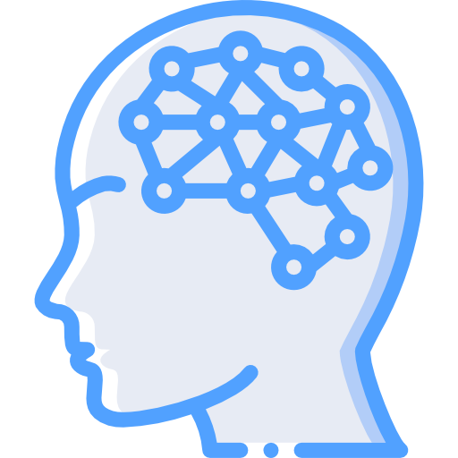
Neural Network: 1950-1970
Computing systems with interconnected nodes that work much like neurons in the human brain.
History
First neural network was conceived of by Warren McCulloch and Walter Pitts in 1943.
Goal
To create a computer like system that could solve problems like a human brain.

Slide 13

Machine Learning: 1980-2010
History
Arthur Samuel coined the term Machine Learning in 1952.
Goal
To train a machine how to learn.

Slide 14
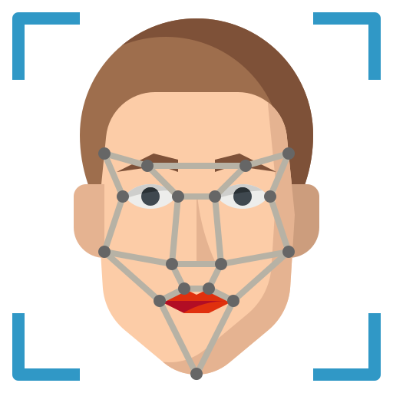
Deep Learning:
Type of machine learning that trains a computer to perform human-like tasks, such as recognizing speech, identifying images or making predictions.
Example: Face recognition
History
1943, Walter Pitts and Warren McCulloch created a computer model based on the neural networks of the human brain.

Slide 15
Now that we have seen how AI has evolved with time.
Let’s understand how it affects our daily life.

Slide 16
What differentiates Automation from AI?
Artificial Narrow Intelligence & Artificial General Intelligence
How AI differs from not AI?
How AI works?
Discussion
Notes:
While AI is often associated with automation, it's important to understand the distinction. Automation involves executing pre-defined tasks, whereas AI involves making decisions based on data. Let's break down these concepts further.

Slide 17

Artificial Narrow Intelligence & Artificial General Intelligence
ANI - Artificial Narrow Intelligence
Oriented around specific tasks.
Ability of computers to perform specific tasks that humans do with their brains.
E.g., E-mails in the inbox getting sorted into spam and not spam automatically.

Slide 18
Artificial Narrow Intelligence & Artificial General Intelligence
AGI - Artificial General Intelligence
Involves cognitive abilities
Machines that can successfully perform any task that a human might do.
E.g., Iron Man’s smart assistant Jarvis. Real examples of AGI remain out of reach as of now.

Slide 19

How AI differs from not AI?
Machine Independence can be considered as Critical differentiator between AI and not-AI.
Independent Machines are equipped with cognitive abilities and can solve problems independently.
Cognitive abilities enables machine to learn, train, and solve problems independently.

Slide 20
What is Automation?
Automation, basically means designing a software or hardware which is capable of automatically doing things without any form of human intervention.
Automation has introduced a system of computer and machines and replaced a system that was built by combining man and machine.

Slide 21
How Automation differs from AI?
 | Automation | AI
Definition | Designing a software or hardware capable of automatically doing things without any form of human intervention | A science as well as engineering which is involved in making machines which are intelligent
Data | All the types of automation which are bound using explicit programming and rules. No usage of Data. | Involves huge quantities of data. Uses neural networks, graphs and deep machine learning
Purpose | Automation can execute repetitive tasks, frees up valuable time. | Designed to seek patterns and learn from experience so that it can self-select the appropriate responses according to situations.
Notes:
Source: Sarmah Simanta, Artificial Intelligence in Automation
https://d1wqtxts1xzle7.cloudfront.net/60715554/14-17_RRIJM19040600420190926-58364-1lht1jb-with-cover-page-v2.pdf?Expires=1630925254&Signature=VuKG7VrNnY-lrWlcc~w2Dj1uArzwILNt-jVbF9vCL-ZOOsRe-xPSrv5QaRFTveCPXMJFiM5MsNJM3ThlbZTWgPwCMivSyQe0QDVdwAGxESiqoEvr-g4qNsWAGQXYl-Ff0wS2cqebMWrL00GPia9q7HuVuvd9isBoj5qK6tqTuMQcK5eDoKTa6diSMa-t6N85ZAdsTAGEfOQPERcQYDXVdkazKLsipaWlUKVK0Mt9Xjq0VsaAOZCnAva6qQBd0grolwujNblsC7ipt9tYoJh1k5R1uilKGxC3ffVBfYaMd7XK9SlhgUK-knEurcbLvcr7rlDwss~MMwYZhsaE9GFbIQ__&Key-Pair-Id=APKAJLOHF5GGSLRBV4ZA

Slide 22

AI Applications and its Drivers
AI Applications
Driving Force behind AI
Future of AI
Notes:
What drives the widespread adoption of AI? Factors include advancements in computing power, the explosion of data, and the need for efficient decision-making. We'll explore how these factors contribute to AI's applications in various fields.

Slide 23
AI Applications
Transport
Healthcare
Education
Agriculture
Manufacturing
Banking
Sports
Entertainment and many more...

Slide 24
Driving Force behind AI
Potential to transform relationship between people and technology.
Unprecedented amount of data.
Ability to self learn and self optimize.
Potential source of business innovation.
Disruptive Emerging Technology
5G
Autonomous Vehicles
Internet of Things
Big Data
Advanced computing chips and processors

Slide 25
Reflections
Course Overview and Orientation
What is Artificial Intelligence?
What differentiates Automation from AI?
Initial AI Applications and Motivations behind developing them.
Notes:
As we wrap up today's session, let's reflect on the key points we've covered. Remember, the journey into AI

Slide 26
Bibliography
Amisha, P. Malik, M. Pathania, et al. Overview of artificial intelligence in medicine J Family Med Prim Care, 8 (2019), pp. 2328-2331
Artificial Intelligence (AI) – What it is and why it matters Retrieved from https://www.sas.com/en_us/insights/analytics/what-is-artificial-intelligence.html#history
Artificial Intelligence Retrieved from https://www.accenture.com/in-en/insights/artificial-intelligence-summary-index
Artificial Intelligence (AI) – What it is and why it matters Retrieved from https://www.sas.com/en_us/insights/analytics/what-is-artificial-intelligence.html#history
Artificial Intelligence Retrieved from https://www.accenture.com/in-en/insights/artificial-intelligence-summary-index

Slide 27
Ethics Spotlight: Algorithmic Bias
Algorithmic bias = systematic and unfair errors in an AI system that disadvantage particular groups
NOT the same as a code bug or a random mistake — bias is patterned and tied to group membership
Common causes: biased training data, biased problem framing, biased proxies for protected attributes
Examples to watch for: hiring tools, loan approval, image recognition, healthcare risk prediction
CLO 6 connection — recognizing bias is foundational to evaluating any AI system you encounter or build

